Slide 1
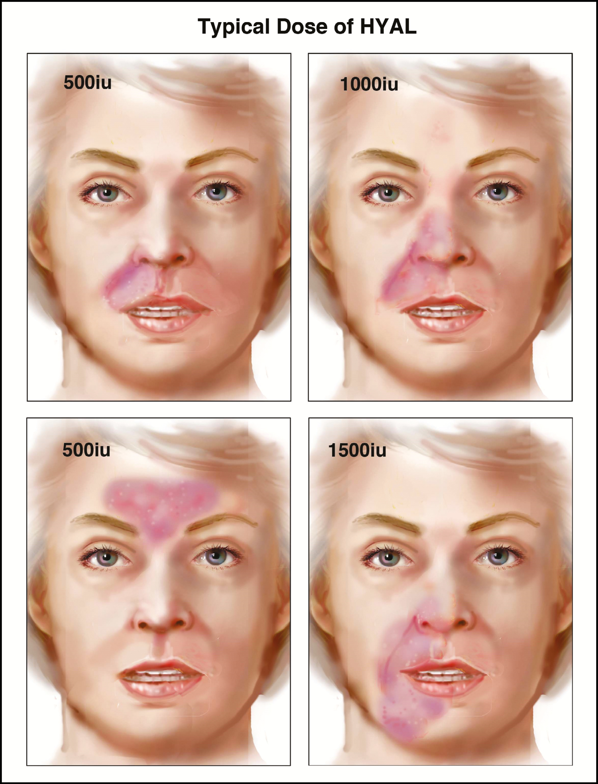
Figure 2. Some common patterns of injury, and the typical doses used by the author for each. HYAL is injected into the ...
Notes:
Figure 2. Some common patterns of injury, and the typical doses used by the author for each. HYAL is injected into the ischemic tissues and gentle massage is then used to maximize the contact time between the ischemic tissues and HYAL. The tissues may be edematous, but gentle massage following injection of HYAL will tend to decrease this. Massage is important to help maximize contact between HYAL and the filler causing the obstruction.
Unless provided in the caption above, the following copyright applies to the content of this slide: © 2017 The American Society for Aesthetic Plastic Surgery, Inc. Reprints and permission: journals.permissions@oup.com

Slide 2
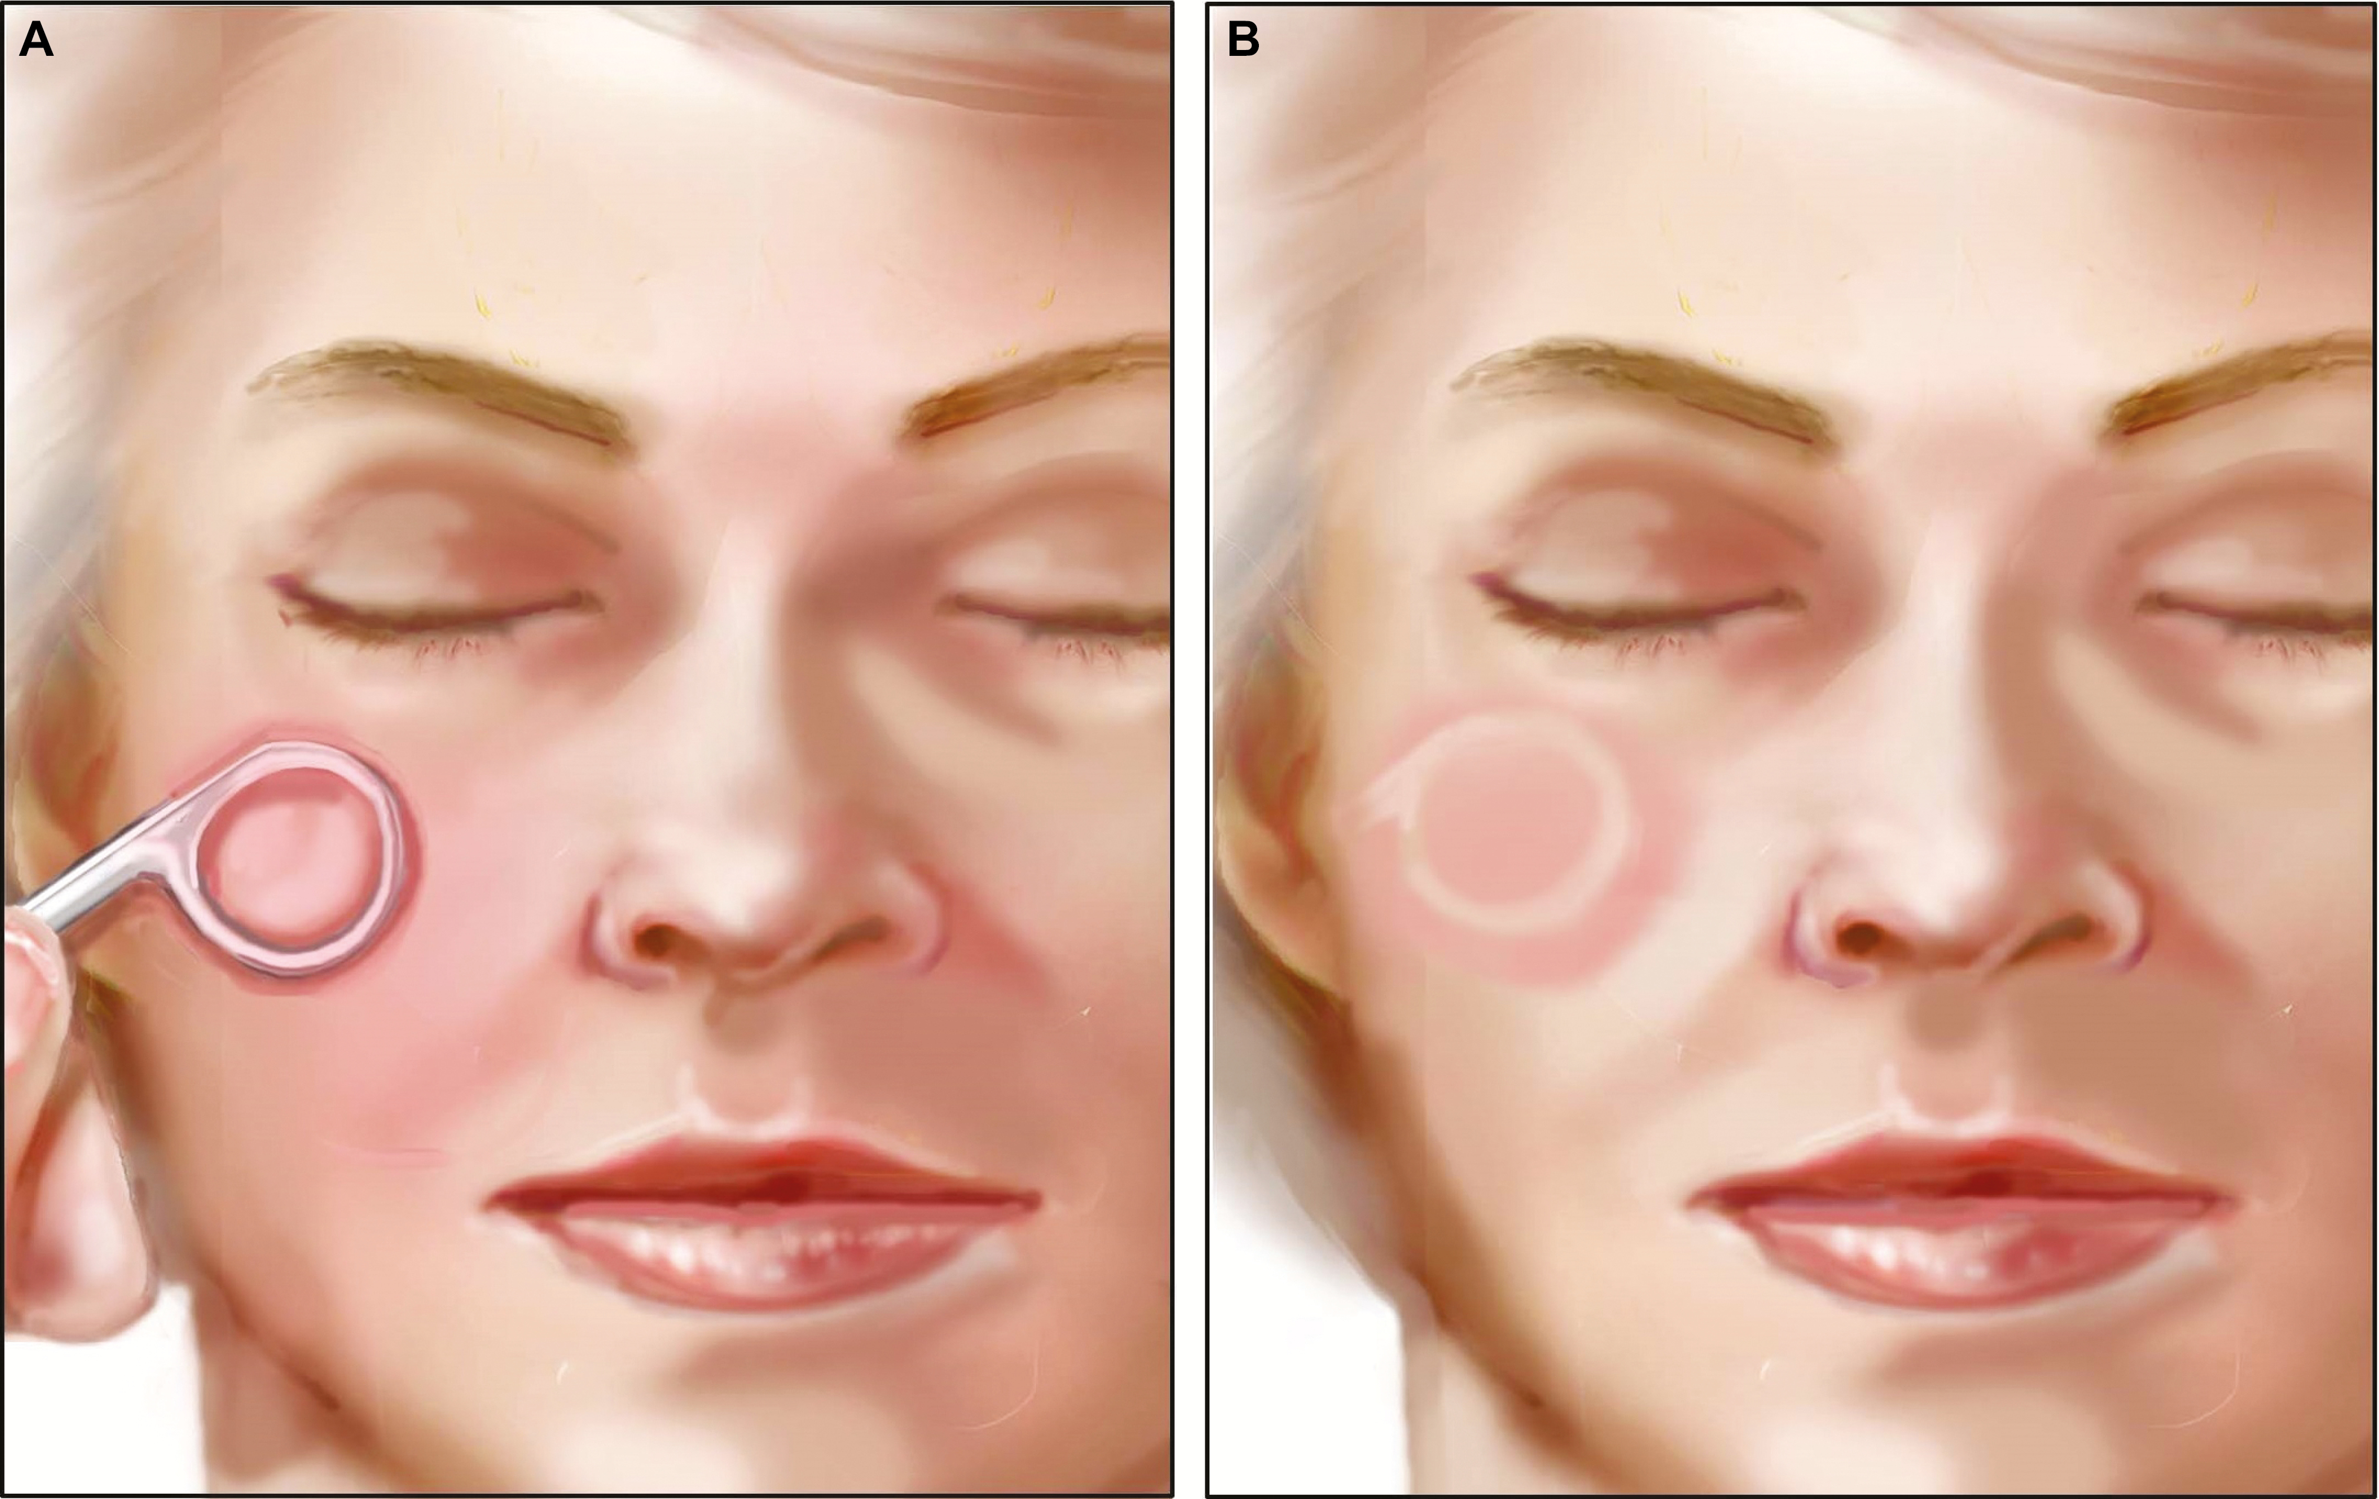
Delayed Cap Refill

Slide 3
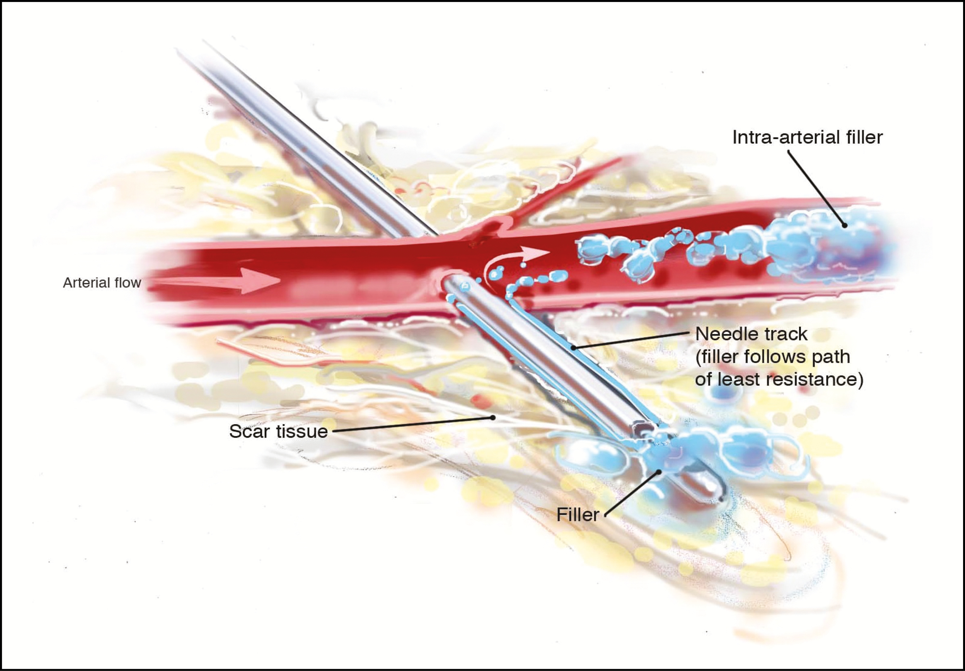

Slide 4
The current clinical practice recommendation is to use a maximum aliquot of 0.1 mL of filler per pass in any one area of the face, and then to move the needle tip slightly before injecting another similar volume, such that if you happened to be in an artery, no more than 0.1 mL of filler would enter the vessel.^{1,7} We reached that number many years ago by estimating the volume of a small artery from typical injection sites on the face to the height of the orbit (unpublished cadaver data), so that if you did happen to put filler into the arterial system, there would not be sufficient volume to flow into the internal carotid territory and thence into the central retinal artery. More recent data on the volume of the Supratrochlear artery (as a representative example of this principle) showed that the average volume is approx. 0.085 mL.⁸ The filler should be injected under low pressure, since high pressure and high flow rates could cause filler to travel to undesirable areas. Finally, it is wise to avoid scarred tissues, and to treat all scars as higher risk areas. If you penetrate an artery by passing a needle or cannula through it and into scarred tissues, you may create a pathway for the filler to pass into the vascular system (Figure 5). The filler may flow retrograde along the needle pathway, and then enter into the lumen of the vessel since this may be the path of least resistance. The author has noted the gritty nature of tissues in long standing filler patients, and is concerned that we may see more vascular AE in the future in our long standing patients, since each subsequent filler treatment adds a little more scar to tissues.¹
Venous outflow obstruction: for most areas of the face, this is a non-issue. Most areas have reliably redundant venous pathways, and if one is blocked, an adjacent one is easily brought into play. The exceptions to this are axial pattern or free flaps, but these are rarely, if ever, the subject of filler treatments.

Slide 5
Ischemia is secondary to mechanical blood flow obstruction by HA filler inside the lumen of arteries
Flooding the tissues around the obstructed vessels with HYAL results in hydrolysis of the HA, relieving the mechanical obstruction to arterial blood flow. The HA fillers break down into smaller and smaller pieces, and eventually these products of HA hydrolysis can pass through the capillaries and allow blood flow to resume
HYAL activity is degraded by various means in a time related fashion (dilution, diffusion, and deactivation). Therefore, its effectiveness decreases rapidly following injection.
The hydrolysis of the filler material is dependent on the concentration of the HYAL in the surrounding tissues, and diffusion into the vessel lumen.
The hydrolysis of the filler material is dependent on the length of time that the obstructed vessel is bathed in a HYAL solution of sufficient concentration to promote diffusion into the vessel.
Products differ in their resistance to HYAL. Crosslinking HA is done to make the product HYAL resistant, so that the benefits of the filler last longer. In general, longer lasting filler products are more HYAL resistant, and are thus more difficult to dissolve with HYAL in this situation.
Ischemia is secondary to mechanical blood flow obstruction by HA filler inside the lumen of arteries
Flooding the tissues around the obstructed vessels with HYAL results in hydrolysis of the HA, relieving the mechanical obstruction to arterial blood flow. The HA fillers break down into smaller and smaller pieces, and eventually these products of HA hydrolysis can pass through the capillaries and allow blood flow to resume
HYAL activity is degraded by various means in a time related fashion (dilution, diffusion, and deactivation). Therefore, its effectiveness decreases rapidly following injection.
The hydrolysis of the filler material is dependent on the concentration of the HYAL in the surrounding tissues, and diffusion into the vessel lumen.
The hydrolysis of the filler material is dependent on the length of time that the obstructed vessel is bathed in a HYAL solution of sufficient concentration to promote diffusion into the vessel.
Products differ in their resistance to HYAL. Crosslinking HA is done to make the product HYAL resistant, so that the benefits of the filler last longer. In general, longer lasting filler products are more HYAL resistant, and are thus more difficult to dissolve with HYAL in this situation.
Ischemia is secondary to mechanical blood flow obstruction by HA filler inside the lumen of arteries
Flooding the tissues around the obstructed vessels with HYAL results in hydrolysis of the HA, relieving the mechanical obstruction to arterial blood flow. The HA fillers break down into smaller and smaller pieces, and eventually these products of HA hydrolysis can pass through the capillaries and allow blood flow to resume
HYAL activity is degraded by various means in a time related fashion (dilution, diffusion, and deactivation). Therefore, its effectiveness decreases rapidly following injection.
The hydrolysis of the filler material is dependent on the concentration of the HYAL in the surrounding tissues, and diffusion into the vessel lumen.
The hydrolysis of the filler material is dependent on the length of time that the obstructed vessel is bathed in a HYAL solution of sufficient concentration to promote diffusion into the vessel.
Products differ in their resistance to HYAL. Crosslinking HA is done to make the product HYAL resistant, so that the benefits of the filler last longer. In general, longer lasting filler products are more HYAL resistant, and are thus more difficult to dissolve with HYAL in this situation.

Slide 6
The author guess-timates the volume of HYAL (150 iu/cc) to be given to be about 3cc for an area of half an upper lip (a very rough approximation that seems to work, clinically). One can try to estimate the volume of tissue involved, and then work to the tissue volume, which seems at first to be the most scientific approach (the HYAL dose should be titrated to a certain volume of tissue). When first deciding on how much HYAL to utilize, the author estimates the volume of tissue is involved, ie, not merely the surface area of the zone of injury. Thus, if the thick tissues of the lateral cheek below the zygoma radial to the upper molar teeth (which measure about 25 mm in cadaver measurements the author has taken, ie, just over twice the thickness of an upper lip) are involved, then more HYAL must be used per unit surface area in comparison to an upper lip (which measures about 12 mm), or glabella (which measures about 6 mm in thickness). In other words, the physician should make some attempt at estimating the volume of ischemic tissue, with a view to using more HYAL if thicker tissues are involved. The underlying assumption is that the blood volume per unit of tissue is approximately uniform in the face. By extension, the intra-arterial space is similar per given volume of tissue. Despite the considerations given above, and the likely benefits of better dosing through better volume estimates, even the very rough dosing based on surface area alone can be sufficient for success (Figure 2).
The author wants to stress that these numbers have arisen through clinical practice alone, and not through scientific testing of any sort. No doubt, these doses will certainly be changed with further investigations. The truth of the matter is that no one really knows the minimum effective dose to use. However, the downside risk of treatment has been very low, and the upside has been high, with full uneventful recovery as the norm, excepting only those cases with delay of onset of treatment or when insufficient HYAL has been used (as in the former protocol).
This protocol relies on the assumptions posted on Table 3. We assume that the embolus of HA material is inside the arterial system, and we assume that by bathing the obstructed vessel in a solution of HYAL of sufficient concentration for a sufficient length of time, the contained HA material will be hydrolyzed by the HYAL (Table 3). The process of breakdown is not likely to be linear. The initial breakdown products of hydrolysis are likely to still be large enough to cause obstruction to blood flow, but it may cause some clinical changes in the shape of the injury as some of the product is “dissolved” and perhaps some corollary vessels open up. It is important to review each case during the treatment, and adjust the injection of HYAL to match the volume of ischemic tissue seen clinically. In some cases, for example, an area of ischemia may involve the upper lip and ipsilateral nose, but after a period of time, the lesion may involve only the part of the original lesion, say the nose in this example. Thus it would be reasonable to reduce the dose of HYAL and to re treat the nasal area only in this example. The author does not know the minimum effective HYAL concentration required to treat the average HA filler embolus (ie, the dose of HYAL that is effective to hydrolyze a given quantity of filler emboli). The effective working strategy of flooding the tissues is almost certainly not the most efficient one. It may be that a lower concentration of HYAL may be equally effective. However, the author argues that higher dosing regimens appear to be clinically safe, and the outcomes better, than when more conservative dosing is used. It appears that we have everything to gain, and little to lose, by using this strategy.
SOURCE OF HYAL DISCLAIMER
Another critical factor is that the author uses HYAL 150 iu/cc compounded in a local pharmacy (York Downs Pharmacy, 3910 Bathurst St, Toronto, Canada) because we do not have any pharmaceutical grade HYAL available legally in Canada. It may be that the HYAL we use in Canada is less or more effective than other brands, despite the fact that the potency given by the pharmacy is 150 iu/cc. Further, it may be that there is more batch to batch variability in a compounded preparation of HYAL in contrast to a strictly controlled pharmaceutical process. The author is assuming that the bovine testicular HYAL prepared at our local compounding pharmacy is actually what it purports to be, and it pharmacologically equivalent to any other equivalent HYAL, but this has not been proven.

